Slide 1
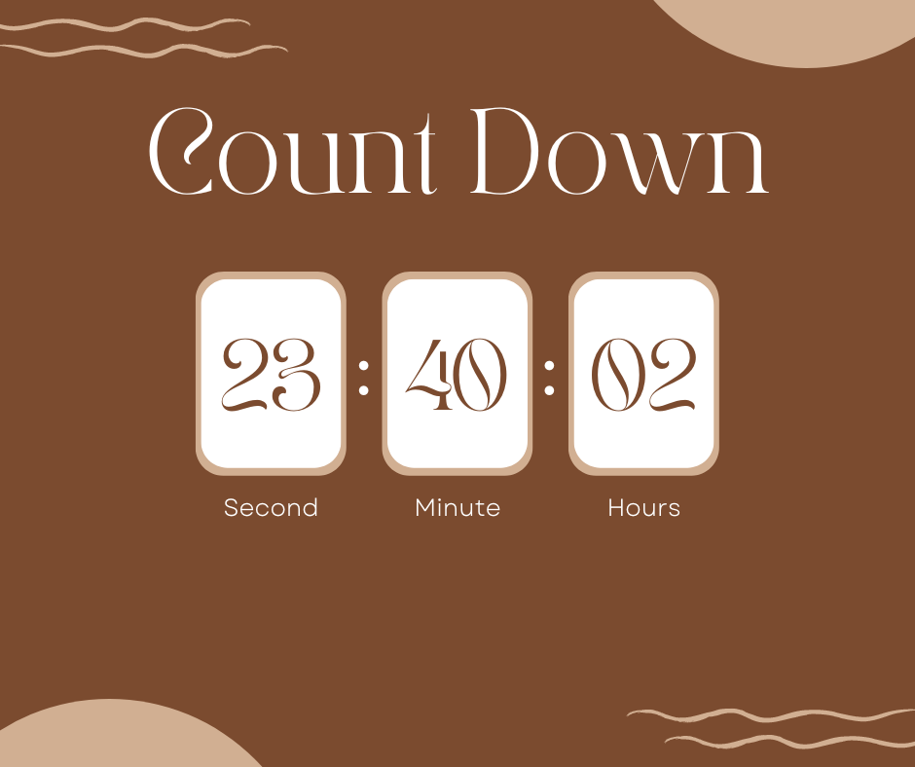
2023
COUNT UP JOY AND FUN

Slide 2
1. Greeting and thank-you: Good morning, everyone. We really appreciate you guys for taking time to listen to our friendly talk.
2. Self-introduction: We’re five IUers sharing with you all the ups and downs during the first semester of this school year.
3.Attention getter: Counting down the seconds before ringing in the fresh
new year is a fantastic event, and it will be a brand-new moment for IU freshmen. We had an unforgettable chance to welcome 2022 with such celebrities such as Trúc Nhân, Vũ Cát Tường,.. and we really had some blasts with them. This exploding event is not only when IU-ers can throw away all pressures but we can also make some new friends or find our crush. Isn’t it interesting?
4.Topic connection: Why don’t we cheer ourselves up with a countdown night in 2023, after all these endless workloads and deadlines wearing out our beautiful youth?
5.Credibility: Luckily, we joined that event last year and we kept wondering how it could be so fascinating. That’s why we are here now to bring you all the thrilling moments we experienced.
6. Preview: We’ll heat up our talk with three main points: why we should ease the pressure after all these brain-wearing exams, how we’ll blast in the event, and what energies we’ll gain back for the next semester.
7. Time for Q&A: Our talk will be about 6-8 minutes. If you have any questions or concerns, please feel free to share with us after that.
8. Transition: First of all, let we tell you how we IUers are dying for this cheerful end-of-year event.

Slide 3
Point 1: First of all, let we tell you how we IUers are dying for this cheerful end-of-year event.
Nothing has more pressure than assignments, projects, quizzes and tests all the year round. When we IUers are loaded with all these stuffs, we tend to breathe our soul out and breathe all the stress of life in. Take me as an example, I have been flooded in deadlines of quizzes, tests, group projects, assignments, and presentations, which definitely has worn my mental health terribly. What we expect next shouldn’t be the new semester; what we expect next should be the joy. We all felt overwhelmed. We all need a blast. We all want the fun.
Even worse, days and months with all study and no play take away our beautiful moments looking for our Mr. Right and Ms. Right, turning us into an army of FAs looking for fun only in the virtual world. There’s a famous saying that “Life is short, the music won’t last, so we should enjoy the dance”. Why don’t we blast with our loved ones? Why don’t we share the fun that our youth deserves?

Slide 4
POINT 2: Now let me move on to the highlight of our talk: how can we enjoy the Countdown?
First, prepare a beautiful heart and soul to welcome your idols. The Countdown is a music festival to celebrate the end of the year, so there will be many popular singers performing onstage. If we’re lucky, we can enjoy the burning moment of the stage in the cool seats. We can have fun, go wild, and send cheers to our idols at that moment. How exciting!
Second, prepare your eye-catching outfits to match your soul-matching moments. We IUers can dress cute at the Countdown; we IUers can dress up as stylish cheerleaders; we IUers can visually blast on our homeland. How cool!
Most expectantly, be civilized fans to make the Countdown a meaningful Vietnamese blast, not a deadly Korean stampede. Don’t push, just sing! Don’t swear, just cheer! And if you don’t have any chance to get near your idols at the Countdown, believe that you will be able to get their autographs later. How fantastic!

Slide 5
POINT 3: So what will we have at the end of the Countdown 2023? Let me tell you.
A reward from joining this shout-and-sing event is that you will yell your best to get rid of all the academic pressures and enjoy life again. According to an article in studyfinds.org, most research suggests that leisure has mental health benefits and that it can make us more productive. Therefore, if we play hard at the year end, we’ll get back more effective when the next year starts.
The sweetest fruit you can pick at the event is your DESTINY is waiting for you to share the cheers. Last year, the fire of all the exciting activities attracted as many as 40.000 participants, not only students from IU but also from other schools like University of Technology, UEL… So definitely it will be the once-in-a-lifetime chance for any FAs looking for besties or partners to welcome Tet with a warmer heart.
Notes:
https://studyfinds.org/party-poopers-stress-depression/

Slide 6
LESSON 10
Summative conclusion

Slide 7
Functions of a good conclusion:
- Prepare the audience for the end
- Review the main points briefly
- Present final appeals

Slide 8
How to prepare the audience?
Language cues:
Well, now that we have seen ….
Ok, let’s go back to… .
Movement cues:
Move back to where you began
Paralinguistic cues:
Slow the rate of the speech, use more pauses

Slide 9
How to review the main points briefly?
Do not just rephrase the main points.
Mention the major details in each main point instead.

Slide 10
How to present final appeals?
Motivate them positively by asking them to:
change their attitude
act in a certain way
understand and trust what you have said

Slide 11
CONCLUSION TEMPLATE
Transition + Tie back to topic
Review with a brief mention of major details
3. Concluding remarks
4. Mention of references
5. Wrap-up and thank-you
6. Question invitation

Slide 12
PRACTICE 1
PUTTING THE BRAKES ON TEENAGE DRIVING
Write a summative review with:
Three points mentioning some major details
Some writing techniques of persuasive writing
http://www.youtube.com/watch?v=3L5VJ2rOltE

Slide 13
PRACTICE 2
COUNTDOWN 2023 – COUNT UP FUN & JOY
Prepare a summative review, including:
Three points mentioning some major details
Some writing techniques of persuasive writing

Slide 14
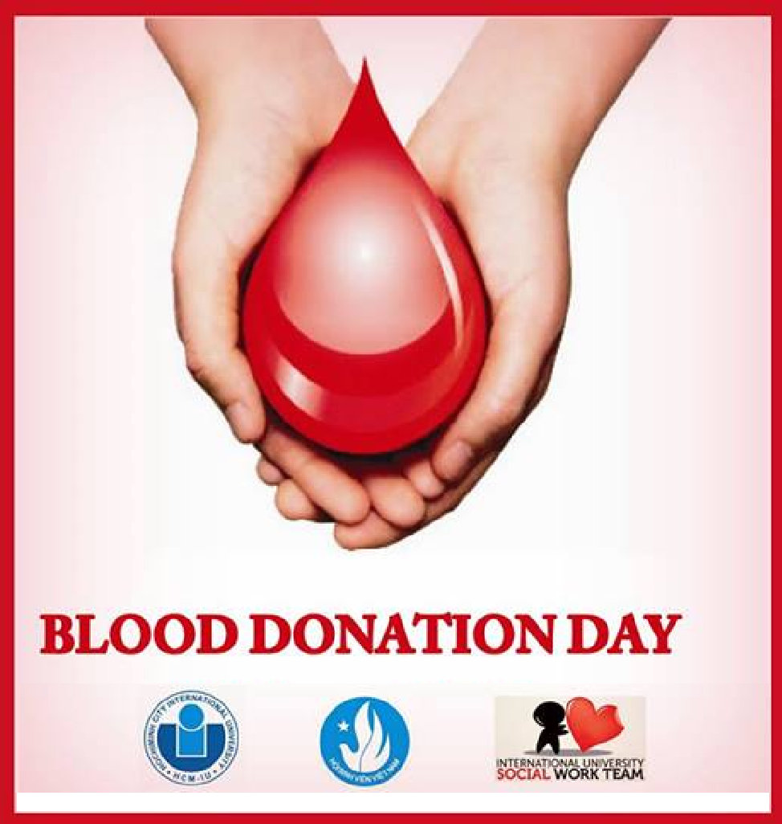
Share Your Love - Save Their Lives
PRACTICE 2

Slide 15
Preview
1. Need for blood donors/donation in our city/country
2. How to join/donate your blood
3. Benefits for your community and yourself

Slide 16
CONCLUSION
Transition + tie back to topic:
As you can see, blood is an essential part of life, and blood donation is an activity that requires the support of not only you, or me, but of every one of us.

Slide 17
Preview:
In my talk today, I’ll tell you why your donation is a great help to society in general and to patients in particular. Then I’ll show you how you can donate your blood in the safest way for both of you and your recipients. Finally, I’ll mention some gains from your activity.
🡪 A poor review:
Well, I’ve just covered three points in my talk: why you should donate your blood, how you can do it, and what you can gain.

Slide 18
Task: Elicit the major details for a summative review

Slide 19
First of all, there’s sad news that “blood shortage is becoming a trend in Vietnam”.
According to WHO, each year our country needs roughly about 1.6 million units of blood for treatments. However, just about 30% of this need is currently met. If you happen to think that 30% is not a small number, I just want you to think of some scenarios.
- If you were in the 70% group, what would you do?
- If you were at the dead-end road, what would you do?
Of course, seizing anything as your last resort is a must, simply because you have no other choices. Therefore, it comes naturally that in these cases, the patients must depend on unreliable sources of blood.
However, the bad news is unreliable usually comes along with illegal. What’s more, illegal and low quality are different two words but just on the same side of one muddy road.
Consequently, in this case, it just makes the matter worse.
To prevent this kind of tragedy from recurring, we must stand up to face it. We must act immediately to reverse this trend. We must find the “healthy blood” to cure this “disease”. And finally, we must deliver this “good guy” quickly to the needy.
Luckily, we don’t need to search far and wide for this “good guy” since he stays inside you, inside me, inside all of us. And all you need to do is open your heart and share your blood.
Generalized:
The lack of blood and the danger of unreliable blood

Slide 20
First of all, there’s sad news that “blood shortage is becoming a trend in Vietnam”.
According to WHO, each year our country needs roughly about 1.6 million units of blood for treatments. However, just about 30% of this need is currently met. If you happen to think that 30% is not a small number, I just want you to think of some scenarios.
- If you were in the 70% group, what would you do?
- If you were at the dead-end road, what would you do?
Of course, seizing anything as your last resort is a must, simply because you have no other choices. Therefore, it comes naturally that in these cases, the patients must depend on unreliable sources of blood.
However, the bad news is unreliable usually comes along with illegal. What’s more, illegal and low quality are different two words but just on the same side of one muddy road.
Consequently, in this case, it just makes the matter worse.
To prevent this kind of tragedy from recurring, we must stand up to face it. We must act immediately to reverse this trend. We must find the “healthy blood” to cure this “disease”. And finally, we must deliver this “good guy” quickly to the needy.
Luckily, we don’t need to search far and wide for this “good guy” since he stays inside you, inside me, inside all of us. And all you need to do is open your heart and share your blood.
Detailed:
The lack of blood of up to 70% and the danger of illegal & low quality blood

Slide 21
Transition: Now that you’ve realized the importance of blood donation. I’ll move on to talk about what you have to prepare for this special day to make it fulfilling.
First of all, keep yourself not only mentally but also physically healthy. In the night before the donation day, you have to go to bed early because it can help you manage the serotonin – a chemical produced in the human brain to control the feelings. In addition, taking any alcohol or stimulants right before the big day is the strictest prohibition. You may have already known how terrible it is if one person receives that bad blood. Therefore, please, be very careful with that. Please keep yourself strong to have the high quality blood in you and in others.
Second, on the big day, remember to wear comfortable clothes with short sleeves or sleeves that can be rolled up to your elbow. Loose costumes will help doctors take out your blood more easily. And don't worry about anything. Our volunteer staffers will take good care of you and we will help you check your health. After completing the procedure, you can start donating your blood. The amount of blood taken depends on your health condition. A cup of sweet tea may balance your blood and get you back to normal after the blood take-out.
Finally, several days after the donation, you need to balance your meals with various types of food: meat, milk, eggs or anything that contains more proteins to ensure the body gets enough nutrients and produces blood to make up for the donated blood. Furthermore, iron plays a vital role in the blood reproducing process in your body, so eating more iron rich food can help you gain new blood quickly after donation.
Generalized:
The things you should do before, during and after your donation

Slide 22
Transition: Now that you’ve realized the importance of blood donation. I’ll move on to talk about what you have to prepare for this special day to make it fulfilling.
First of all, keep yourself not only mentally but also physically healthy. In the night before the donation day, you have to go to bed early because it can help you manage the serotonin – a chemical produced in the human brain to control the feelings. In addition, taking any alcohol or stimulants right before the big day is the strictest prohibition. You may have already known how terrible it is if one person receives that bad blood. Therefore, please, be very careful with that. Please keep yourself strong to have the high quality blood in you and in others.
Second, on the big day, remember to wear comfortable clothes with short sleeves or sleeves that can be rolled up to your elbow. Loose costumes will help doctors take out your blood more easily. And don't worry about anything. Our volunteer staffers will take good care of you and we will help you check your health. After completing the procedure, you can start donating your blood. The amount of blood taken depends on your health condition. A cup of sweet tea may balance your blood and get you back to normal after the blood take-out.
Finally, several days after the donation, you need to balance your meals with various types of food: meat, milk, eggs or anything that contains more proteins to ensure the body gets enough nutrients and produces blood to make up for the donated blood. Furthermore, iron plays a vital role in the blood reproducing process in your body, so eating more iron rich food can help you gain new blood quickly after donation.
Detailed:
no stimulants, just sugary supplements and nutritious food; enough sleep, loose clothes and relaxed feelings that you should have before, during and after your donation

Slide 23
The most important gain that needs to be mentioned first thing first is that you will have a sense of satisfaction when you can help your fellow men to live their lives. In fact, this is the biggest reward because after all, we all live in a society and we need to have social responsibility, right? Well, would it surprise you if I told you that each and every one of you could save 18 lives every year? Well, this statement is very true according to the website www.healthcarecommunication.com. It’s not a boast if we call you a great hero!
In addition, did you know that you can reduce your risk of heart disease and save a life at the same time? That’s right! According to studies published in the American Journal of Epidemiology, blood donors are 88% less likely to suffer a heart attack and 33% less likely to suffer any type of cardiovascular event. Why is that? One explanation is that iron has a significant impact on atherosclerosis, or hardening of the arteries. When you give blood, you are removing 225 to 250 milligrams of iron from your system, thus cutting your risk of heart disease.
Another benefit that you can gain is you can replenish, or refresh your blood. After donating, the human body replaces the blood volume within 48 hours of donation, and all of the red blood cells lost during donation are completely replaced within four to eight weeks. This process can help your body stay healthy and work more efficiently and productively.
Generalized:
the great support for society and personal benefits

Slide 24
The most important gain that needs to be mentioned first thing first is that you will have a sense of satisfaction when you can help your fellow men to live their lives. In fact, this is the biggest reward because after all, we all live in a society and we need to have social responsibility, right? Well, would it surprise you if I told you that each and every one of you could save 18 lives every year? Well, this statement is very true according to the website www.healthcarecommunication.com. It’s not a boast if we call you a great hero!
In addition, did you know that you can reduce your risk of heart disease and save a life at the same time? That’s right! According to studies published in the American Journal of Epidemiology, blood donors are 88% less likely to suffer a heart attack and 33% less likely to suffer any type of cardiovascular event. Why is that? One explanation is that iron has a significant impact on atherosclerosis, or hardening of the arteries. When you give blood, you are removing 225 to 250 milligrams of iron from your system, thus cutting your risk of heart disease.
Another benefit that you can gain is you can replenish, or refresh your blood. After donating, the human body replaces the blood volume within 48 hours of donation, and all of the red blood cells lost during donation are completely replaced within four to eight weeks. This process can help your body stay healthy and work more efficiently and productively.
Detailed:
the social support when you can save as many as 18 lives a year and your less risk of heart disease and blood renewal as a result

Slide 25
BASIC REVIEW ☹
Before I end my talk, let me run through the 3 main points again. First, I’ve told you about the problems of blood shortage in our city. Second, I’ve mentioned how you can help. Last, I’ve pointed out some benefits you can gain.

Slide 26
BETTER REVIEW 😐
Before I end my talk, let me run through the 3 main points again. First, I’ve told you about the urgency of the lack of blood in our community and the danger of the unsafe blood. Second, I’ve mentioned the things you should do before, during and after your donation. Last, I’ve pointed out the considerable gains for society and yourself.

Slide 27
BEST REVIEW ☺
Before I end my talk, let’s recap the key takeaways. Our country is facing the lack of blood of up to 70% and the danger of illegal & low quality blood. If you open your heart and lend your hand, remember the principle: no stimulants, just sugary supplements and nutritious food; enough sleep, loose clothes and relaxed feelings that you should have before, during and after your donation. In return, you will be rewarded with the true bliss when you can save as many as 18 lives a year, less risk of heart disease and blood renewal for yourself.

Slide 28
CONCLUSION TEMPLATE (Cont)
3. So after all, would you like to do something in your ability to save people’s lives? And if you think you can, or you should, welcome to our Blood Donation Day!
4. If you need to know more about our program and other information related to blood donation, you can visit these websites.
5. This brings me to the end of my talk. Thank you so much for your attention.
6. Now, I’ll be glad to answer any question that you may have.

Slide 29
PRACTICE
Putting the Brakes on Teenage Driving
https://www.youtube.com/watch?v=3L5VJ2rOltE&ab_channel=MrCreativeProfessor

Slide 30
Link to submit:
Group 24
https://drive.google.com/drive/folders/13K82ejQLYi8xeqVFZTEHJe9gE2oPJ2r-?usp=sharing

